Slide 1


Memory Interfacing, Stack and Subroutines in 8085
Presented by
Mahbubur Rahman
Lecturer
Department of Computer Science and Engineering(CSE)
Green University of Bangladesh(GUB)

Slide 2
Outline
02
Memory Interfacing in 8085
Stack in 8085
Subroutines in 8085

Slide 3
Memory Interfacing in 8085
03

Slide 4
Memory Interfacing in 8085
04
Interface is a path of communication between two components. Interfacing is nothing but connecting outside peripherals to 8085 μP. Interfacing is a technique of connecting μP with memory.
When μP is executing an instruction, it needs to access the memory for reading instruction codes and the data.
For interfacing, both the memory and the μP require some signals to read from and write to registers. Interfacing process needs to match the memory requirements and μP signals.
Memory Mapping: It is the process of assigning address range to each memory IC in a microcomputer.

Slide 5
Memory Connection
05
8085 Microprocessor: 16 Address Lines (A0 – A15)
8085 Microprocessor: Memory addressing capacity: 2¹⁶ = 64 KB memory.
Addresses start from 0000H to FFFFH ( Addresses of the memory locations which can be addressed by the 8085 microprocessor.)
More than one memory chips are connected to processor.
Sum of all memory sizes ≤ processor’s memory addressing capacity.
Maximum size of memory connected to 8085 is 64KB, which can be any combination of different memory sizes. (1KB, 2KB, 4KB, 8KB, 16KB)
Individual memory is identified by its address range so each memory device should have unique address range.

Slide 6
Memory Interfacing Signals
06
8085 microprocessor uses the three control signals for the interfacing:
IO/M’: Input/Output or Memory
RD’: Read
WR’: Write
In response to these three signals the memory chips have also some signals:
CE’ or CS’: Chip enable or Chip select signal
OE’ or RD’: Output Enable or Read Signal (Read Operation)
WE’ or WR’: Write Enable or Write Signal (Write Operation)

Slide 7
Memory Interfacing Signals
07
IO/M’ RD’ WR’
0 0 1 - 8085 reads data from memory
0 1 0 -8085 writes data into the memory
These three signals are combined to generate two signals MEMR’ and MEMW’.
IO/M’ + RD’ = MEMR’ (0+0=0)
IO/M’ + WR’ = MEMW’ (0+0=0)
If IO/M’=1 then MEMR’ and MEMW’ signals will be deactivated irrespective of the value of RD’ and WR’ signals.

Slide 8
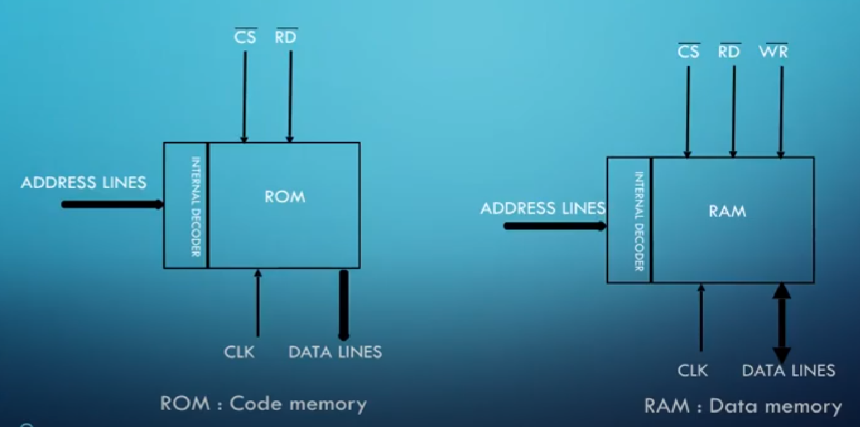
RAM / ROM
08

Slide 9
Memory Interfacing
09
Control signals of the memory are connected to MEMR’ and MEMW’ generated from the processor’s control signals.
Data lines of the memory are directly connected to the processor’s data lines.
As number of address lines differ in the memory and the microprocessor (memory has less no. of address lines)
Connect the required address lines (starting from lower order) from processor to memory.
Remaining address lines of the processor are decoded to connect it to chip select (CS’) of memory to generate unique address range for the decoder.

Slide 10
Example 01
10
Memory chip: 256 registers = 256 Bytes. What is starting address and ending address for this memory chip?
2^{n} = no of registers. For this case, 256 = 2⁸ . So n = 8 = address lines
A15 | A14 | A13 | A12 |  | A11 | A10 | A9 | A8 |  | A7 | A6 | A5 | A4 |  | A3 | A2 | A1 | A0
0 | 0 | 0 | 0 |  | 0 | 0 | 0 | 0 |  | 0 | 0 | 0 | 0 |  | 0 | 0 | 0 | 0
0 | 0 | 0 | 0 |  | 0 | 0 | 0 | 0 |  | 1 | 1 | 1 | 1 |  | 1 | 1 | 1 | 1
Now, A15 to A8 represents CS’
Address range for memory chip: 0000h to 00FFh

Slide 11
Example 02
11
Memory chip: 1KB = 1024 Bytes = 2¹⁰ Bytes = 2¹⁰ X 8
So n = 10 = address lines, 8 = data bus
A15 | A14 | A13 | A12 |  | A11 | A10 | A9 | A8 |  | A7 | A6 | A5 | A4 |  | A3 | A2 | A1 | A0
0 | 0 | 0 | 0 |  | 0 | 0 | 0 | 0 |  | 0 | 0 | 0 | 0 |  | 0 | 0 | 0 | 0
0 | 0 | 0 | 0 |  | 0 | 0 | 1 | 1 |  | 1 | 1 | 1 | 1 |  | 1 | 1 | 1 | 1
Now, A15 to A10 represents CS’
Address range for memory chip: 0000h to 03FFh

Slide 12
Example 03
12
Starting address: 0344h. Memory chip: 1KB = 1024 Bytes = 2¹⁰ Bytes = 2¹⁰ X 8
So n = 10 = address lines, 8 = data bus
A15 | A14 | A13 | A12 |  | A11 | A10 | A9 | A8 |  | A7 | A6 | A5 | A4 |  | A3 | A2 | A1 | A0
0 | 0 | 0 | 0 |  | 0 | 0 | 0 | 0 |  | 0 | 0 | 0 | 0 |  | 0 | 0 | 0 | 0
0 | 0 | 0 | 0 |  | 0 | 0 | 1 | 1 |  | 1 | 1 | 1 | 1 |  | 1 | 1 | 1 | 1
For basic case: Address range for memory chip: 0000h to 03FFh
If starting address is 0344h: then ending address: 0344h + 03FFh = 0743h

Slide 13
Example 04
13
Determine the starting address of 4KB memory with ending address BA3F H.
Solution:
OFFSET = Ending address when starting address is 0000 H
Starting address = Ending address – OFFSET
Ending address = Starting address + OFFSET
4KB = 4 X 1 KB = 4 X 1024 X 8 = 2² X 2¹⁰ X 8 = 2¹² X 8
= 2^{n} X y (Size of ROM), where n is address lines and y is data lines
0000 H = 0000 0000 0000 0000 (Starting address)
0FFF H = 0000 1111 1111 1111 (Ending address)
Now, Starting address = Ending address – OFFSET = BA3F – 0FFF = AA40 H

Slide 14
Example 05
14
Problem: Determine the size of memory whose starting and ending address are 4A00 H and 69FF H respectively.
Solution:
Size of memory = Ending address – Starting address = 69FF – 4A00 = 1FFF H
Now, 1FFF H = 0001 1111 1111 1111
(Thirteen 1s are there. These 1s represent the number of address lines. Data lines are 8)
So, Memory size = 2^{n} X y (Where, n = address lines and y = data lines)
= 2¹³ X 8 = 2³ X 2¹⁰ X 8 (Since, 2¹⁰ X 8 = 1 KB)
= 2³ X 1KB = 8 KB (Answer)

Slide 15
Example 06
15
Representation of memory chip is 2^{m} X n
Where, m = number of address bus & n = number of data bus
Example: 1 KB = 2¹⁰ Bytes = 1024 X 8 memory = 2¹⁰ X 8 memory
m = address lines = 10 & n = data lines = 8.
Problem: Find the length of address and data bus of 2048X512 memory chip.
Solution: 2048 X 512 = (2¹¹) X 512
So, length of address = 11 and number of data lines = 512

Slide 16
Example 07
16
Number of memory ICs required to construct a memory
Number of ICs required = Memory to be designed / Available capacity.
Problem: Construct 32 KB memory using 256 X 4 ICs/chip.
Solution: Number of 256X4 ICs = [ 32 X 2¹⁰ X 8 ] / [ 256 X 4 ]
= [ 32 X 2¹⁰ X 8 ] / [ 2⁸ X 4 ]
= 32 X 2² X 2 = 32 X 4 X 2 = 256 [Answer]
Altogether there will be 128 rows and in each row there are two 256X4 ICs
Because in 32KB, there are 8 data line whereas in 256X4, there are 4 data lines.

Slide 17
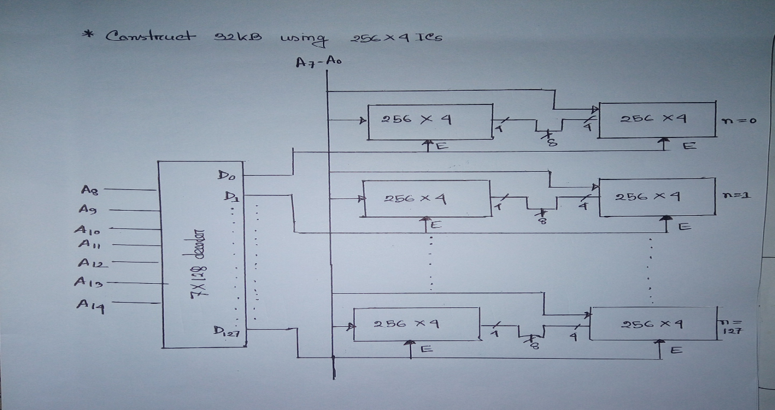
Example 07 (continued)
17

Slide 18
Example 08
18
Problem: Find number of 256X8 ROM chip required to design 8KB of memory.
Solution: 256 X 8 = 256 B and 256X4 = 1024 B = 1 KB
To design 1 KB requires 4 chips
So, to design 8 KB requires = 8X4 = 32 Chips.
Solution:
Number of Chips = 8 KB / (256 X 8)
= [ 8 X 2¹⁰ X 8 ] / [ 2⁸ X 8]
= 8 X 2² = 8 X 4 = 32

Slide 19
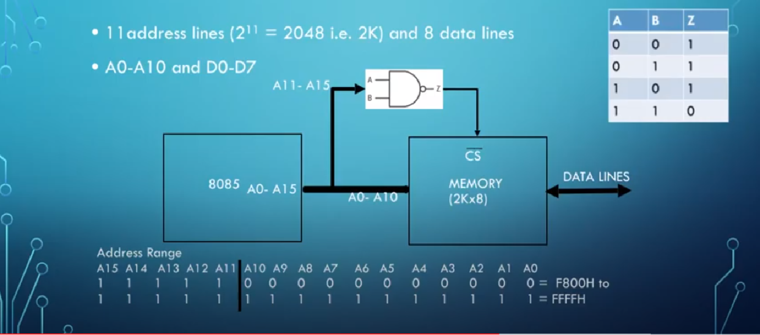
Example 09 (2K X 8 Memory)
19

Slide 20
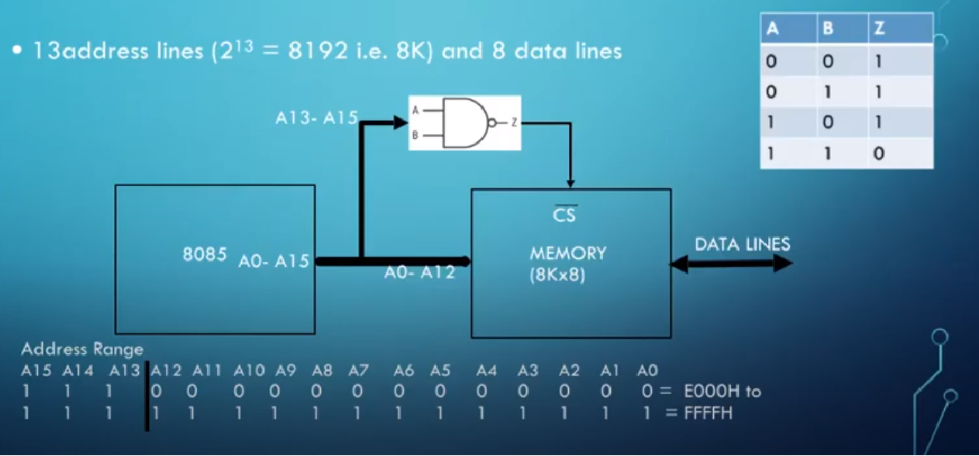
Example 10 (8K X 8 Memory)
20

Slide 21
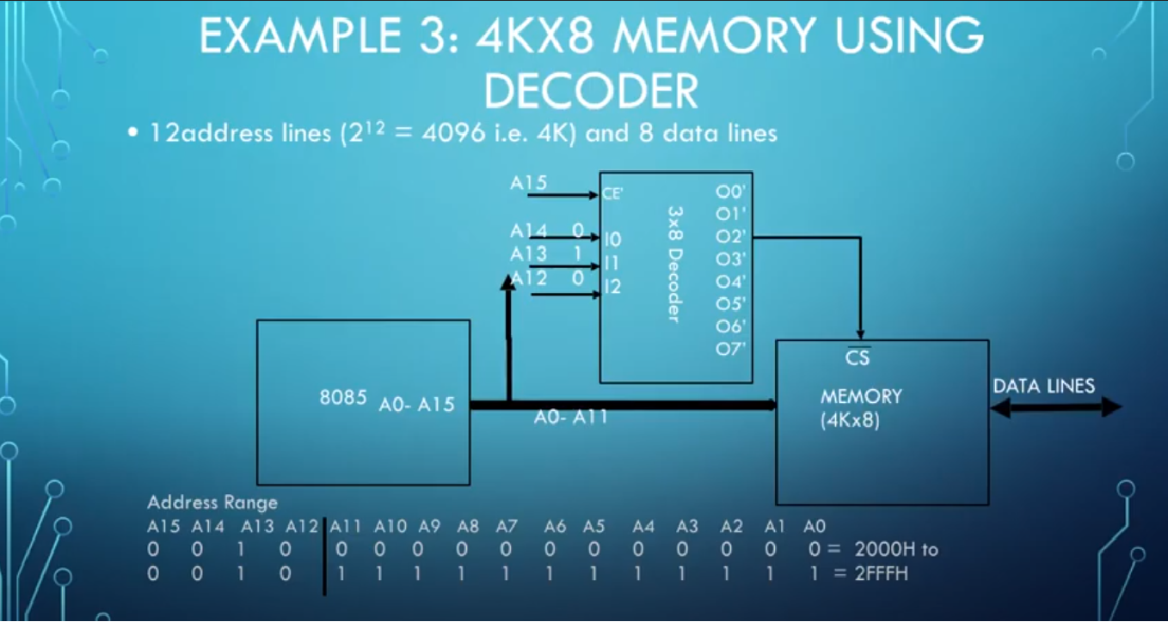
Example 11 (4K X 8 Memory using Decoder)
21

Slide 22
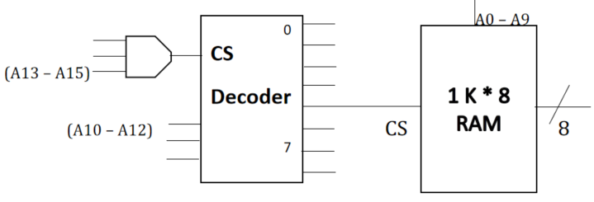
Example 12
22
Problem: An 8-bit microprocessor has 16-bit address bus (A0 – A15) with a 1KB memory chip as shown in the figure. What is the address range for the chip?
A15 | A14 | A13 | A12 |  | A11 | A10 | A9 | A8 |  | A7 | A6 | A5 | A4 |  | A3 | A2 | A1 | A0
1 | 1 | 1 | 1 |  | 0 | 0 | 0 | 0 |  | 0 | 0 | 0 | 0 |  | 0 | 0 | 0 | 0
1 | 1 | 1 | 1 |  | 0 | 0 | 1 | 1 |  | 1 | 1 | 1 | 1 |  | 1 | 1 | 1 | 1
Address range for memory chip: F000h to F3FFh

Slide 23
Stack in 8085
23

Slide 24
The Stack
24
The stack is a group of memory location in the R/W memory that is used for temporary storage of binary information during the execution of a program.
The stack is a LIFO (Last in First out) structure.
The starting location of the stack is defined by loading a 16-bit address into the stack pointer that space is reserved, usually at the top of the memory map.
The stack normally grows backwards into memory.
The stack can be initialized anywhere in the user memory map, but stack is initialized at the highest memory location so that there will not be any interface with the program.

Slide 25
Information is stored and retrieved from the stack
25
The 8085 provide two instruction PUSH and POP for storing information on the stack and retrieving it back.
Information in the register pairs stored on the stack in reverse order by using the instruction PUSH.
Information retrieved from the stack by using the instruction POP.
PUSH and POP both instruction works with register pairs only.
The storage and retrieval of the content of registers on the stack follows the LIFO (Last in first out) sequence.
Information in the stack location may not be destroyed until new information is stored in that memory location.

Slide 26
Example
26
In 8085 microprocessor system the beginning of the stack is defined in the program by using the instruction.
LXI SP, 16 bit.
The LXI SP, a 16 bit state that load the 16 bit address into the stack pointer register.
2000 LXI SP, 2099H | Load the stack pointer register with the address 2099
2003 LXI H, 42F2H | Loads data in the HL register pair
2006 PUSH H | The content of the HL register pair pushed into stack
2007 DELAY COUNTER
200F ↓
2010 POP H | Saved data in stack pointer register to HL register pair

Slide 27
Operation of the stack
27
During pushing the stack operates in a “decrement then store” style.
The stack pointer is decremented first, then the information is placed on the stack.
During popping the stack operates in a “use then increment” style.
The information is retrieved from the top of the stack and then the pointer is incremented.
The SP pointer always points to “the top of the stack”.

Slide 28
PUSH H
28
A
42 | F2
2097
F
B
C
D
E
The stack pointer is decremented by one to 2098H and the contents of the H register are copied to memory location 2098H.
The stack pointer register is again decremented by one to 2097H and the contents of the L register are copied to memory location 2097H.
The contents of the register pair HL are not destroyed; however HL is made available for delay counter.
H
L
SP
Contents of the Stack and the Register
after PUSH instruction
Memory
F2
42
X
2097
2098
2099

Slide 29
POP H
29
A
42 | F2
2099
F
B
C
The contents of the top of the stack location shown by the stack pointer are copied in the L register and the stack pointer register is incremented by one to 2098H.
The contents of the top of the stack (now it is 2098 H) are copied in the H register, and the stack pointer is incremented by one.
The contents of the memory location 2097H and 2098H are not destroyed until some other data bytes are stored in these location.
D
E
H
L
SP
Contents of the Stack and the Register
after POP instruction
Memory
F2
42
X
2097
2098
2099

Slide 30
PUSH PSW register pair
30
PUSH PSW (1 byte instruction)
Decrement SP
Copy the contents of register A to the memory location pointed to by SP.
Decrement SP.
Copy the contents of Flag register to the memory location pointed to by the SP.
A
12 | 80
Flag
80
12
FFFB
FFFC
FFFD
FFFE
FFFF

Slide 31
POP PSW register pair
31
POP PSW (1 byte instruction)
Copy the contents of the memory location pointed to by the SP to flag register.
Increment SP.
Copy the contents of the memory location pointed to by the SP to register A.
Increment SP.
A
12 | 80
Flag
80
12
FFFB
FFFC
FFFD
FFFE
FFFF

Slide 32
Subroutine in 8085
32

Slide 33
Subroutines
33
A subroutine is a group of instruction written separately from the main program to perform a function that occurs repeatedly in the main program.
when a main program calls a subroutine the program execution is transferred to the subroutine after the completion of the subroutine, the program execution returns to the main program.
The microprocessor uses the stack to store the return address of the subroutine.
The 8085 has two instructions for dealing with subroutines:
The CALL instruction is used to redirect program execution to the subroutine.
The RET instruction is used to return to the main program at the end of the subroutine.

Slide 34
Subroutines
34
The CALL instruction (CALL, 16 bit)
Call subroutine is conditionally located at the memory address specified by the 16 bit operand.
This instruction places the address of the next instruction on the stack and transfer the program execution to the subroutine address.
The RET instruction
Return unconditionally from the subroutine.
This instruction locates the return address on the top of the stack and transfers the program execution back to the calling program.

Slide 35
Advantages of Subroutine
35
Decomposing a complex programming task into simpler steps.
Reducing duplicate code within a program.
Enabling reuse of code across multiple programs.
Improving tractability or makes debugging of a program easy.

Slide 36
General characteristics of CALL and RTE instruction
36
The CALL instructions are 3-byte instruction; the second byte specified the low order byte and the third byte specifies the high order byte of the subroutine address.
The Return instructions are 1-byte instruction.
A CALL instruction must be used in conjunction with a Return instruction in the subroutine.
Necessary steps to implement a subroutine:
The stack pointer register must be initialized, preferably at the highest memory location of the R/W memory.
The CALL instruction should be used in the main program accompanied by the RET instruction in the subroutine.

Slide 37
Conditional CALL and RTE instructions
37
The 8085 supports conditional CALL and conditional RTE instructions.
The same conditions used with conditional JUMP instructions can be used.
CC, call subroutine if carry flag is set.
CNC, call subroutine if carry flag is not set.
RC, return from subroutine if carry flag is set.
RNC, return from subroutine if carry flag is not set.

Slide 38
Subroutine in 8085
38
In computers, a subroutine is a sequence of program instructions that perform a specific task, packaged as a unit.
This unit can then be used in programs wherever that particular task have to be performed.
A subroutine is often coded so that it can be started (called) several times and from several places during one execution of the program, including from other subroutines, and then branch back (return) to the next instruction after the call, once the subroutine task is done.
It is implemented by using Call and Return instructions.

Slide 39
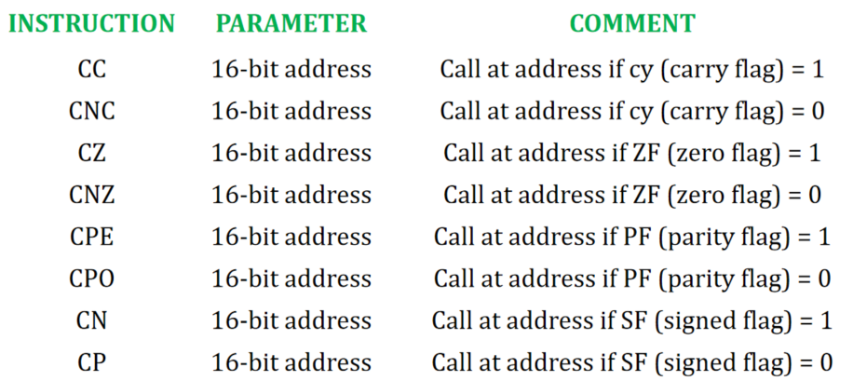
Call instruction
39
Unconditional Call instruction: CALL address is the format for unconditional call instruction. After execution of this instruction program control is transferred to a subroutine who's starting address is specified in the instruction. Value of PC (Program Counter) is transferred to the memory stack and value of SP (Stack Pointer) is decremented by 2.
Conditional Call instruction: In these instructions program control is transferred to subroutine and value of PC is pushed into stack only if condition is satisfied.

Slide 40
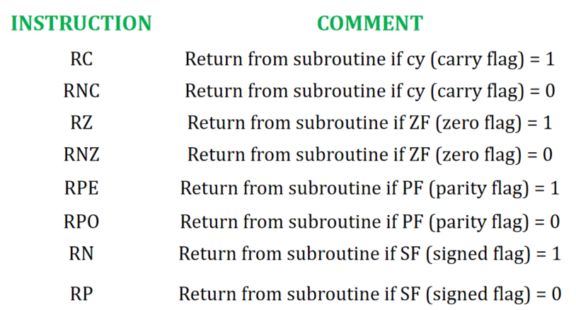
Return instruction
40
Unconditional Return instruction: RET is the instruction used to mark the end of subroutine. It has no parameter. After execution of this instruction program control is transferred back to main program from where it had stopped. Value of PC (Program Counter) is retrieved from the memory stack and value of SP (Stack Pointer) is incremented by 2.
Conditional Return instruction: By these instructions program control is transferred back to main program and value of PC is popped from stack only if condition is satisfied. There is no parameter for return instruction.

Slide 41
Thank You
41

